Slide 1
Taufik Rendi Anggara, S.Si, M.T, LA (IRCA), PCEP, CIBIA
Pemrograman Mobile
Chap 3
Slicing Technique / Layouting

Slide 2
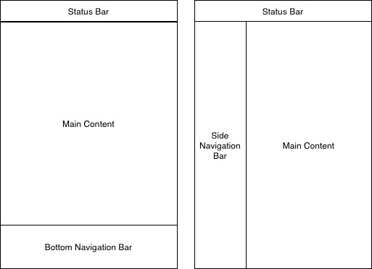
Layout Component

Slide 3
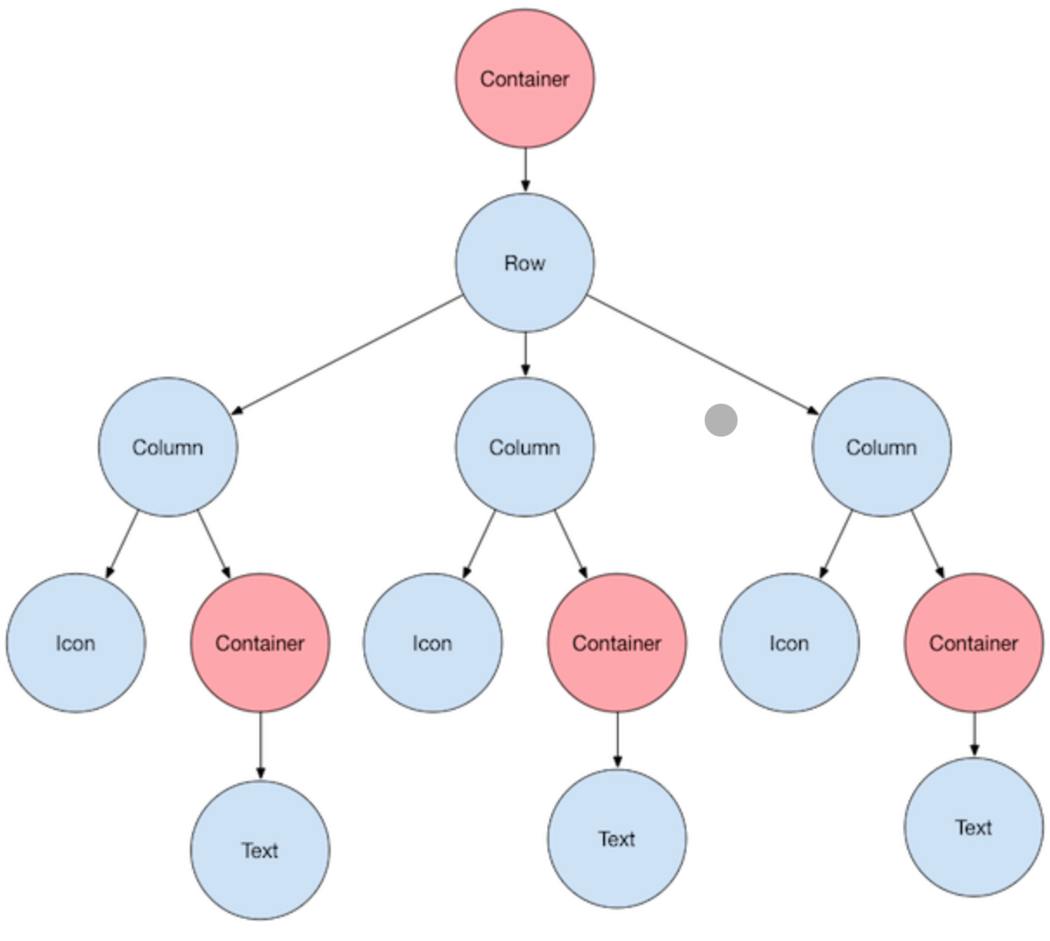
Basic Flutter Layout

Slide 4
Apa itu Widget pada Flutter? Widget adalah Semua komponen seperti button, text, icon dan sebagainya yang membentuk sebuah tampilan atau kerangka aplikasi. Keseluruhan dari aplikasi yang terlihat pada layar merupakan kumpulan widget.
Standard Widgets :
Standard widgets di flutter terdiri dari: Container, GridView, ListView, Stack.

Slide 5
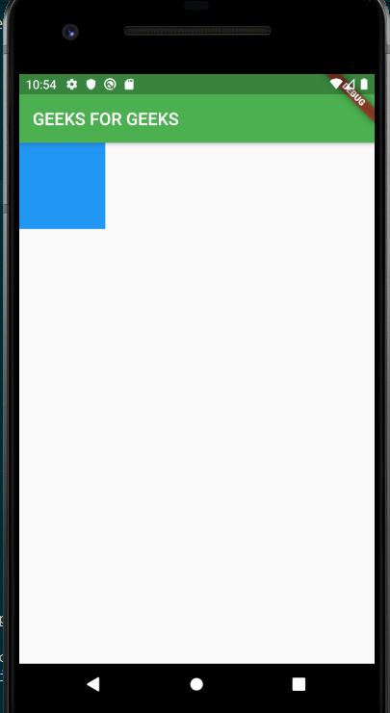
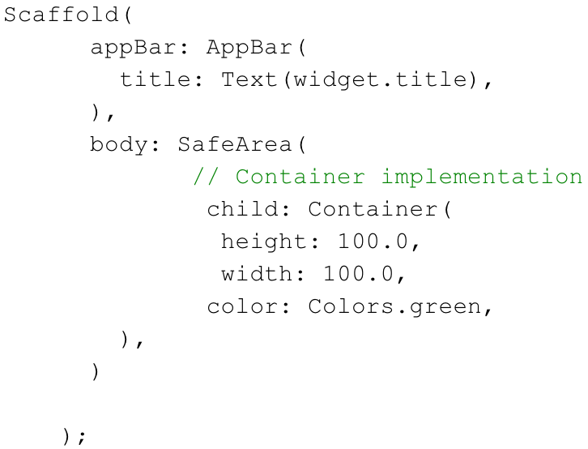
Standard Widget - Container
The container is the most used widget in flutter. We can add padding, margin, border, and background color-like properties in this widget and we can customize it according to our requirement. It contains only a single widget or child.

Slide 6
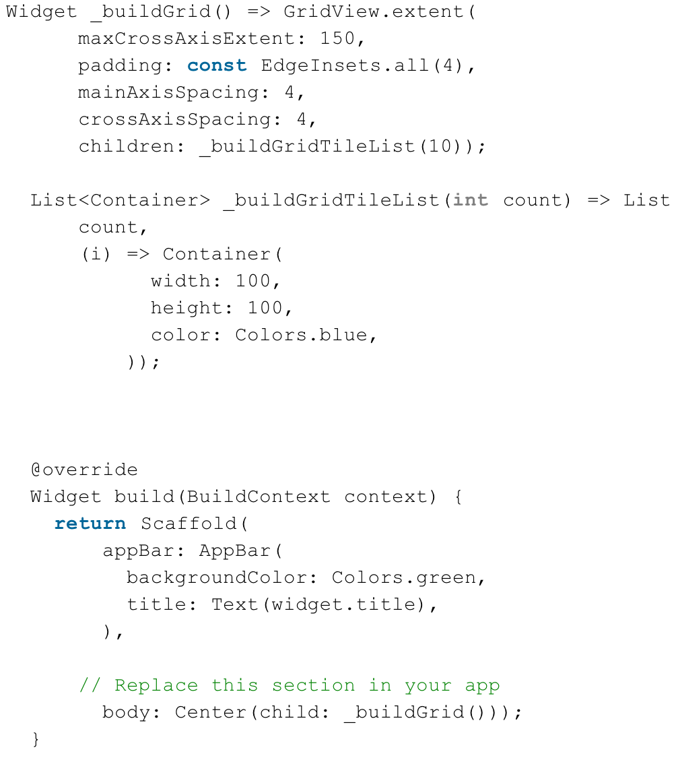
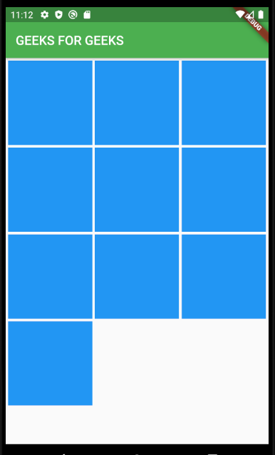
Standard Widget – Grid View
Grid view widget is a two-dimensional scrollable list, by default it provides two pre-fabricated lists, but you can customize it and build your custom grid.
You can change grid.count property and specify the number of columns.
gridView.extend allows the maximum pixel width of a tile.

Slide 7
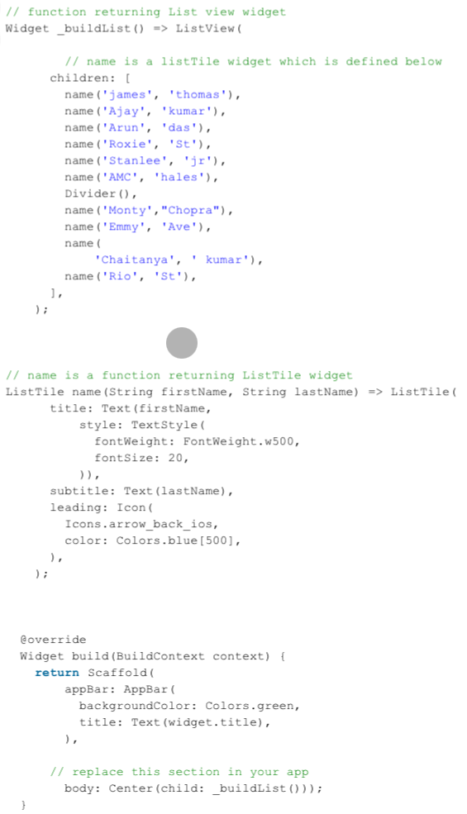
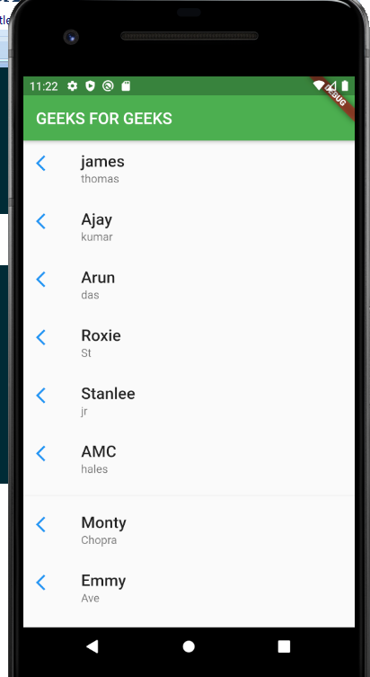
Standard Widget – List View
List view is like a column widget, but it has a plus that is it can be scrollable. Listview can be horizontal or vertical. If the contents in the list view are not fitting then it adds scrollable functionality.

Slide 8
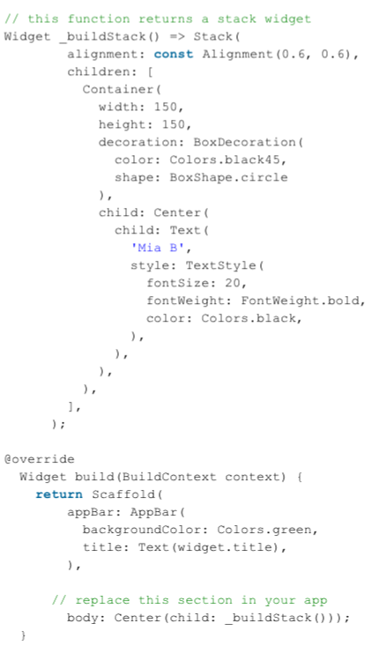
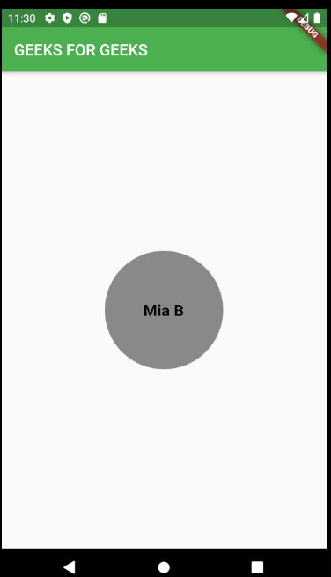
Standard Widget -Stack
Everybody knows the meaning of stack, i.e on top of another. Exactly this widget serve in that way we can put the widget on top of another.
The First widget in the list of children is the base widget; subsequent children are overlaid on top of that base widget.
The stack can not be scrollable.
This is not similar to column widget, in column widget the children are in a column fashion that is one after another not overlapping to each other, but in the stack widget case we can see the widgets can be overlapped to each other.

Slide 9
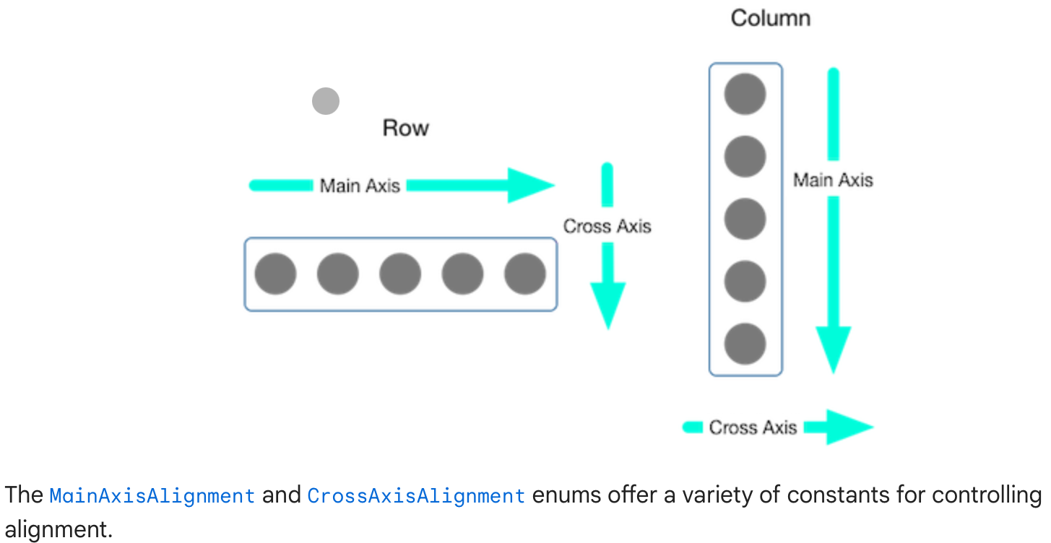
Aligning Widget
You control how a row or column aligns its children using the mainAxisAlignment and crossAxisAlignmentproperties. For a row, the main axis runs horizontally and the cross axis runs vertically. For a column, the main axis runs vertically and the cross axis runs horizontally.

Slide 10
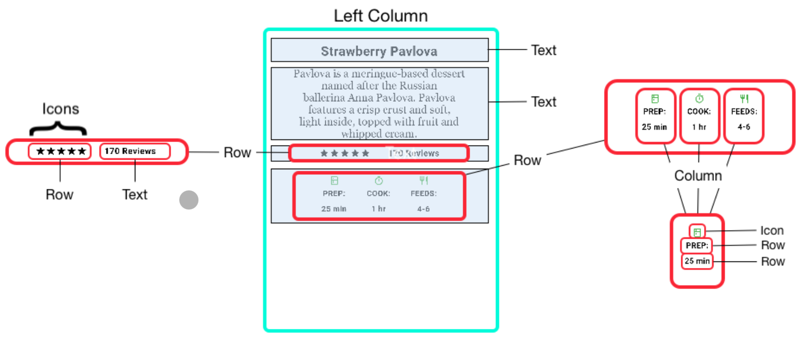
Sample Layout

Slide 11
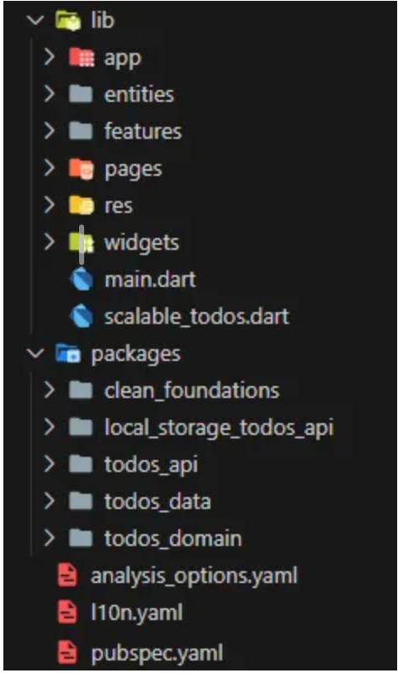
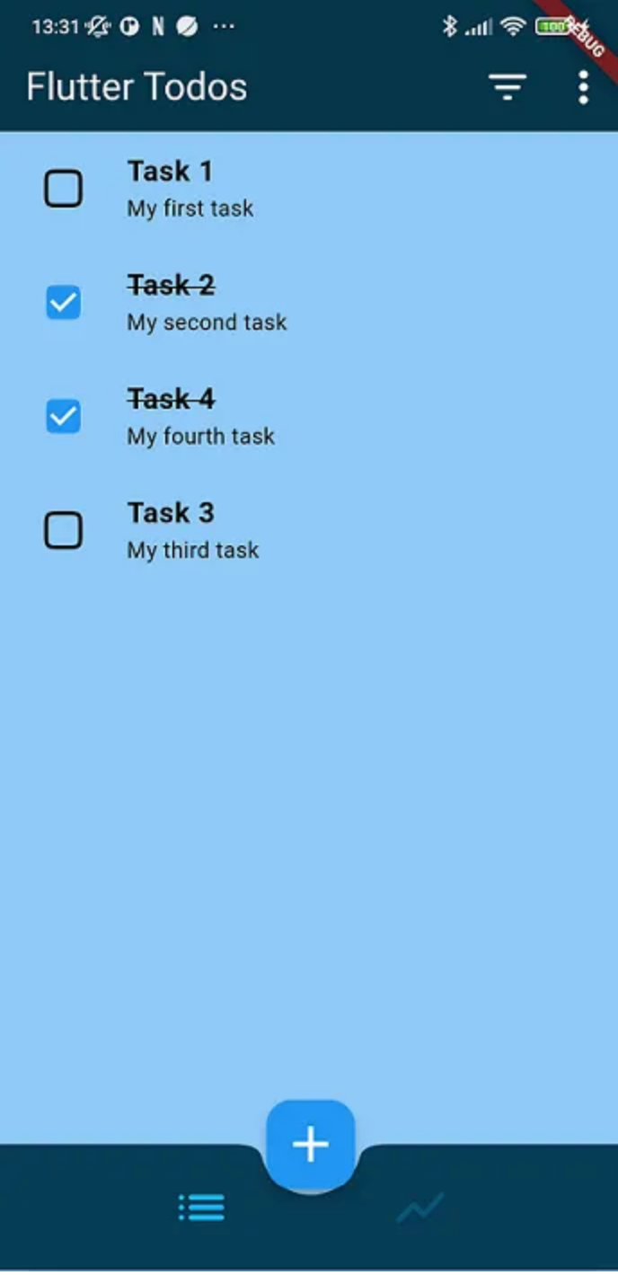
Sample Layout (2)

Slide 12
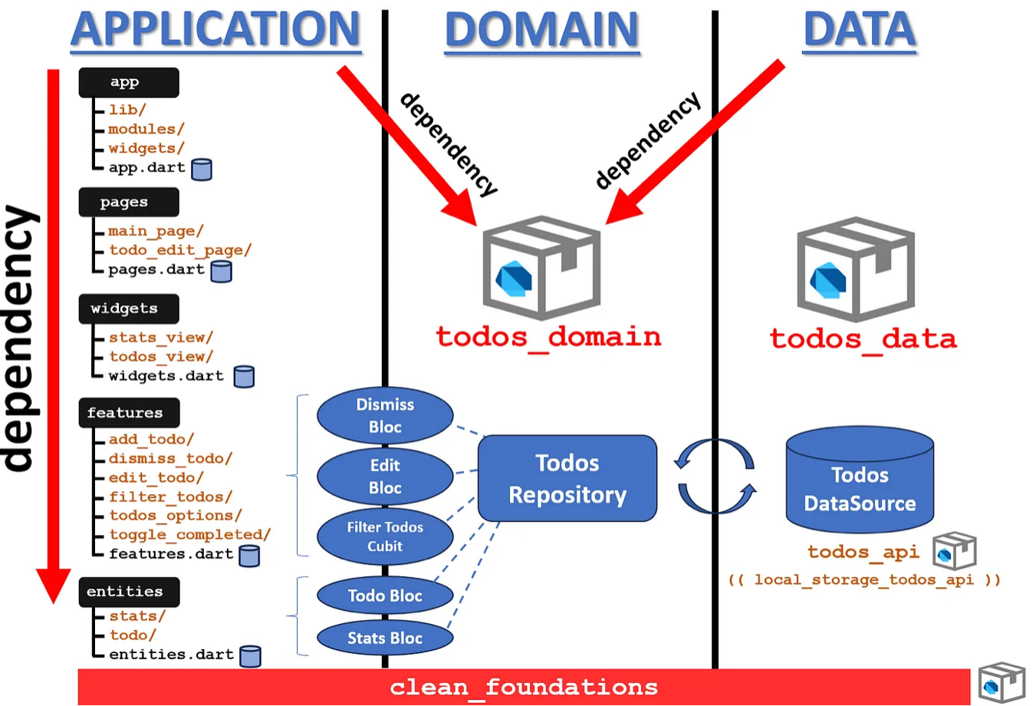
Continued..

Slide 13
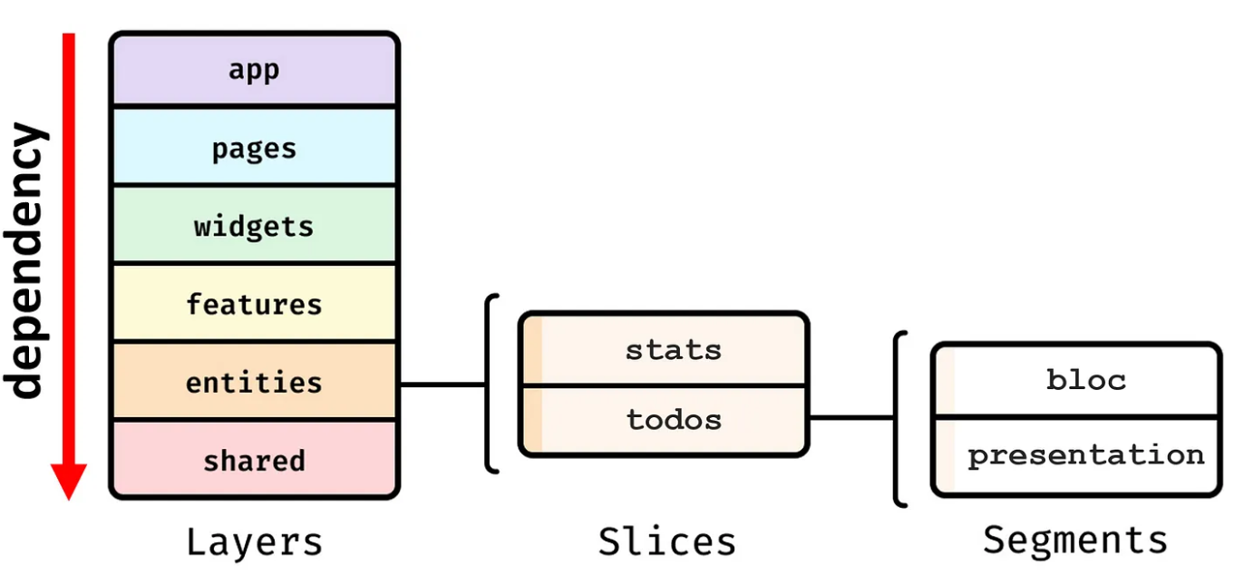
Continued..

Slide 14
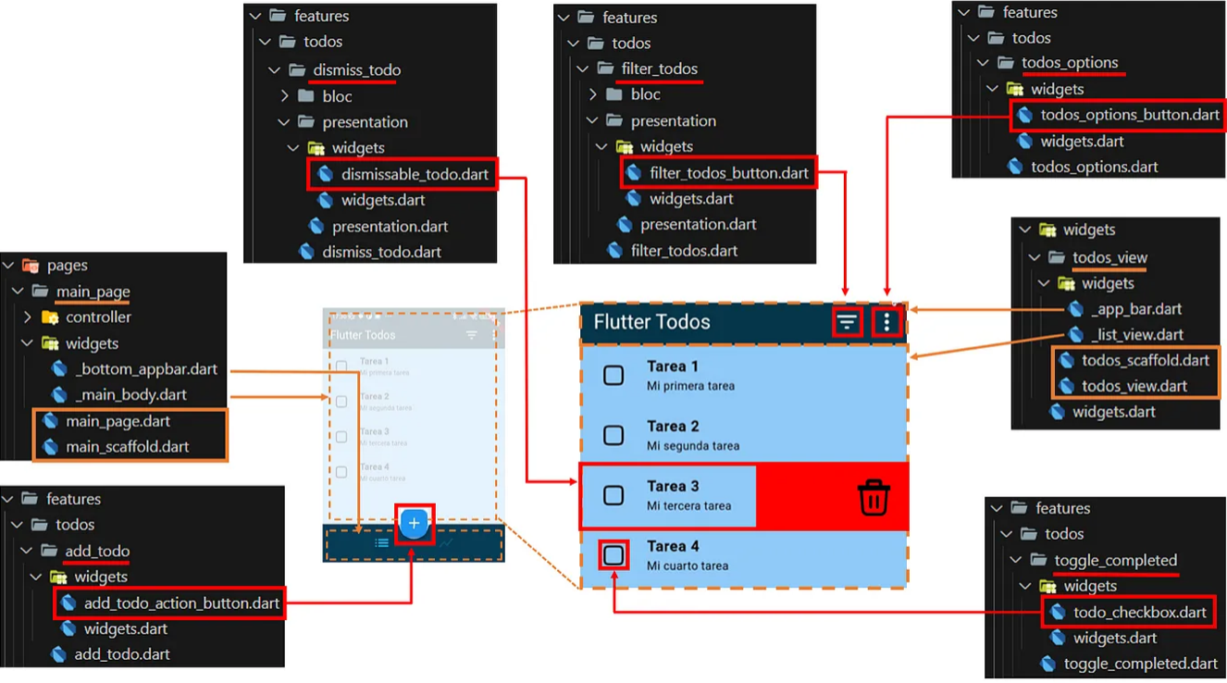
Slicing Folder & Code Technique

Slide 15
Homework Task
Deadline 10 Oct 24 at 23:59
Create Open github account
Create folder Tugas 1
Create Starting flutter project
Send Link of your GitHub Account to email : lordrendi@gmail.com
Title: <Nim_Nama_Class_code_Name of Course>
Body: Link of GitHub Account
Late sending of task will be not get any score
Don’t Copy your Friend Code or both of you will get ZERO SCORE

Slide 16
Terima Kasih

